Slide 1



Introduction
Welcome to the Internship Management System! Our goal is to revolutionize internship management by providing a digital solution to address manual processes, communication gaps, data security concerns, and inefficient evaluation.
by B Hemanth Goud

Slide 2
Existing Problem
Manual Processes
Communication Gaps
Current internship management relies heavily on manual processes, leading to time-consuming tasks and potential errors.
Lack of effective communication channels between students, faculties, and HODs often results in misunderstandings or delays.
Data Security Concerns
Inefficient Evaluation
The absence of a secure digital platform puts sensitive student and company data at risk.
The current evaluation process lacks efficiency, making it difficult to assess the performance of students during internships.

Slide 3

Proposed Solution
1
Streamlined Operations
Our Internship Management System offers a centralized platform to streamline internship processes, including applications, assignments, and evaluations.
2
Enhanced Communication
We provide dedicated channels for students, faculties, and HODs to communicate seamlessly, ensuring clear and timely information exchange.
3
Improved Data Security
With advanced security measures, we prioritize the confidentiality and integrity of student and company data.
4
Efficient Evaluation
Our system incorporates automated evaluation tools to simplify the assessment process and provide valuable insights into student performance.

Slide 4

Project Overview
The Internship Management System is designed to streamline the entire internship process, from application to evaluation, utilizing a user-friendly interface that caters to students, faculties, and HODs.

Slide 5

Tools UtilizedFrontend: HTML, CSS, JavaScript Backend: Django Database: SQLite Version Control: Git

Slide 6
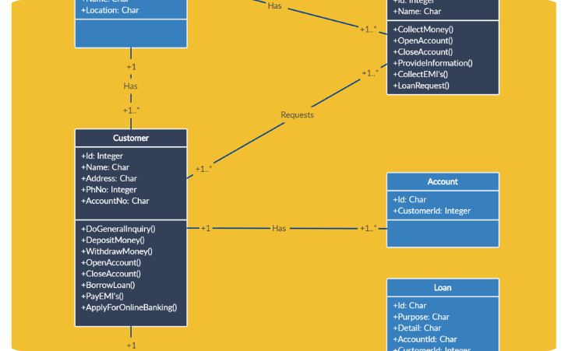
Class Diagram
Class Diagram
Visual representation of the system's classes and their relationships, ensuring a clear understanding of the system's structure.

Slide 7
Student Faculty Mapping Algorithm
1
Step 1: Data Collection
Gather student and faculty information to analyze their preferences and areas of expertise.
2
Step 2: Matching Algorithm
Implement an algorithm that pairs students with faculties based on their interests and skills.
3
Step 3: Automatic Assignment
Assign students to faculty members using the matching algorithm, ensuring optimum mentorship and guidance.

Slide 8
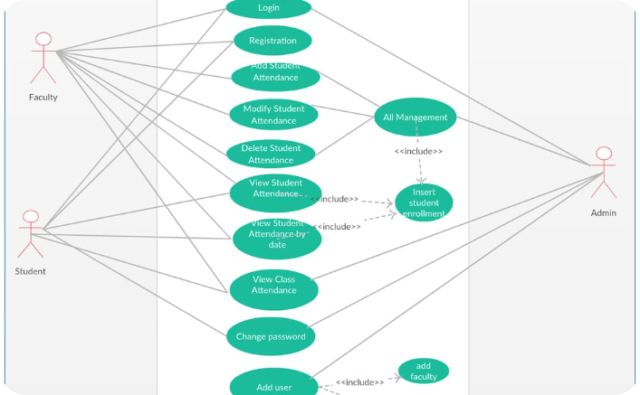
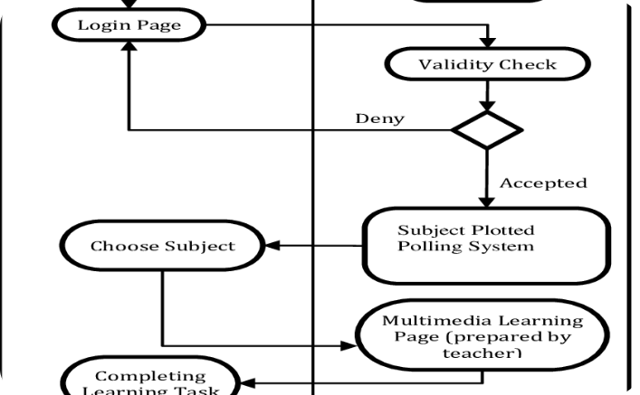
Student Use Case and Activity Diagram
Use Case Diagram
Activity Diagram
Illustrates the functionalities available to students, outlining their interactions with the system.
Visualizes the step-by-step actions a student takes while using the Internship Management System.

Slide 9
Student Login and respective functionalities
Student Login
Accepted Student
Completed Student
Access personal dashboard
View assigned faculty mentor
Submit final internship report
View internship opportunities
Submit weekly progress reports
Provide feedback on the internship experience
Submit internship applications
Communicate with faculties
Access internship certificate

Slide 10
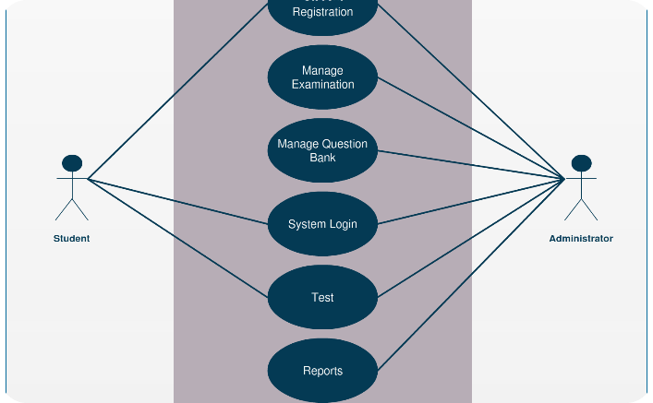
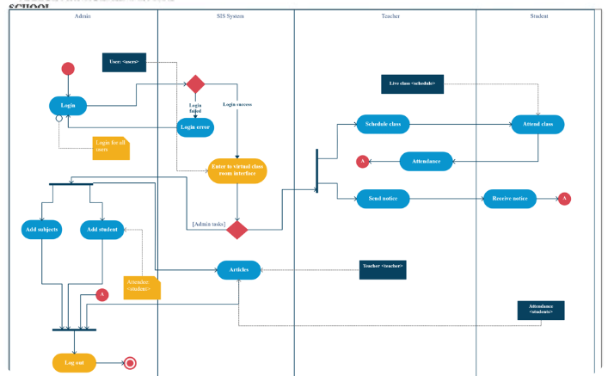
Faculty Use Case and Activity Diagram
Use Case Diagram
Activity Diagram
Illustrates the functionalities available to faculties, outlining their interactions with the system.
Visualizes the step-by-step actions a faculty member takes while using the Internship Management System.

Slide 11
Faculty Login and respective functionalities
Faculty Login
Task Allocation
Internship Evaluation
Access faculty dashboard
Create and assign tasks to students
Assess and rate student performance
View assigned students
Provide feedback on student progress
Monitor task completion status
Generate performance reports
Communicate with students
Provide feedback to students

Slide 12
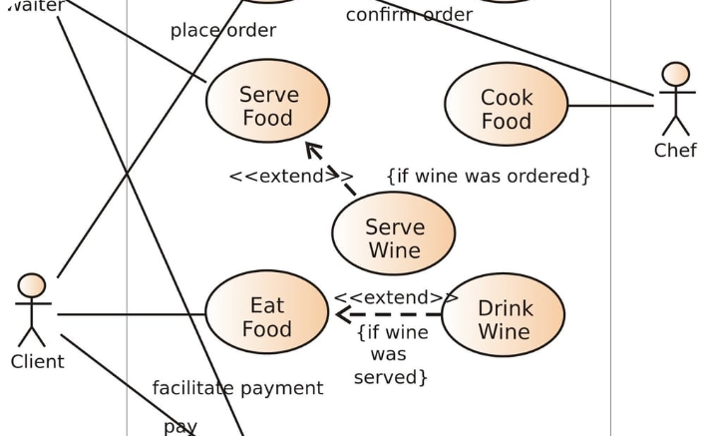
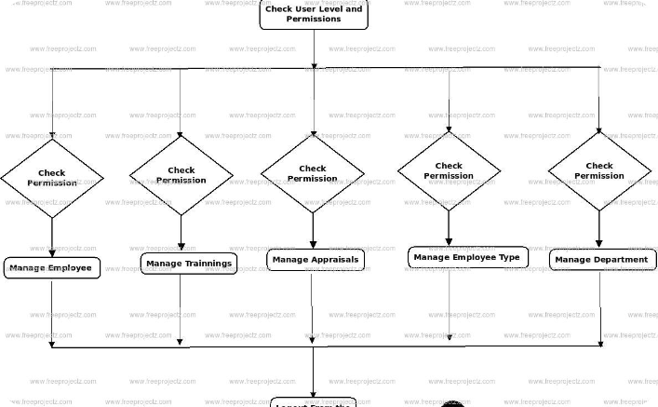
HOD Use Case and Activity Diagram
Use Case Diagram
Activity Diagram
Illustrates the functionalities available to HODs, outlining their interactions with the system.
Visualizes the step-by-step actions an HOD takes while using the Internship Management System.

Slide 13
HOD Login and respective functionalities
HOD Login
Monitor Internship
Generate Reports
Access HOD dashboard
Track student progress and faculty engagement
View comprehensive internship reports
Manage faculties and students
Resolve issues and conflicts
Analyze data for decision-making
Approve/reject internship applications
Communicate with students, faculties, and companies
Identify areas for improvement

Slide 14
Django Backend - Admin User
User Authentication
Data Management
Admin Dashboard
Implement secure login and authorization mechanisms to protect system resources and ensure only authorized access.
Utilize Django's ORM to efficiently manage database operations, including student and faculty information, internship details, and evaluation records.
Create an intuitive admin dashboard with functionalities specific to system administrators, such as user management, system configuration, and analytics.

Slide 15

Future Scope
1
Internship Analytics
Integrate data analytics capabilities to derive insights from internship data and identify trends and patterns.
2
Mobile Application
Develop a mobile application for students, faculties, and HODs to access the Internship Management System on the go.
3
Industry Partnerships
Establish collaborations with companies to enhance internship placement opportunities for students and strengthen industry-academic partnerships.
4
Machine Learning
Incorporate machine learning algorithms for automated student-faculty matching based on historical data and performance indicators.

Slide 16

Thank You
Thank you for joining us on this journey to transform internship management. Together, we can empower students, faculties, and HODs with a dynamic and efficient system. Let's make internships unforgettable!

Slide 17
Front-end Tools
HTML
CSS
The backbone of every web page, HTML provides the structure and semantic elements to create a rich user interface.
CSS empowers styling and visual enhancements, enabling captivating designs and a pleasing user experience.
JavaScript
Bootstrap
JavaScript adds interactivity and dynamic functionality, making web applications more engaging and responsive.
This popular front-end framework provides a responsive grid system and pre-designed components for faster development.

Slide 18
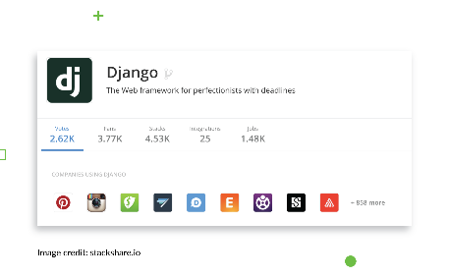

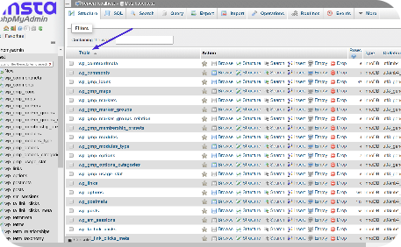
Back-end Tools
Django
Python
MySQL Lite3 Database
A high-level Python web framework that simplifies the development of robust and scalable back-end solutions.
A versatile programming language known for its readability and extensive libraries, ideal for implementing complex logic.
A lightweight, yet powerful, relational database management system that ensures efficient data storage and retrieval.

